Slide 1
New Generation Polymorphic Encoders
Ege Balcı

Slide 2
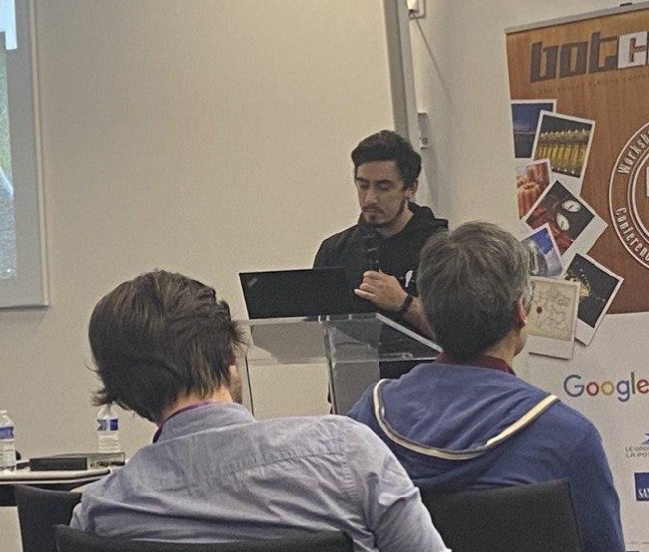
Ege Balcı
Security Researcher @ INVICTUS/PRODAFT
Github: egebalci
Twitter: @egeblc
Blog: pentest.blog

Slide 3
PROBLEMS/MOTIVE
01
GENERIC ENCODER LOGIC
02
PRIOR WORK
AV DETECTION VECTORS
TABLE OF CONTENTS
04
03
REIMPLEMENTATION
05
FINAL PRODUCT
06
WHY WE NEED BETTER ENCODERS?
HOW ENCODERS WORK?
ADFL/LFSR
WHAT NOT TO DO?
BETTER POLYMORPHİSM !
NO LOOP !
NEW GENERATION SGN

Slide 4
01
PROBLEMS/MOTIVE

Slide 5
MOTIVES
I need a very good encoder !
Undetectable with rule based static analysis
Bad character filter support
Can be used as a library

Slide 6
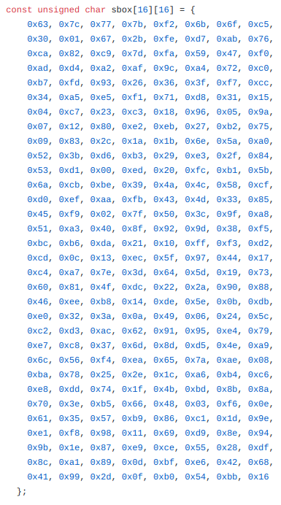
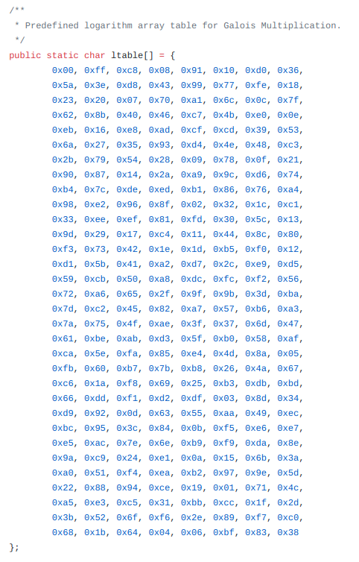
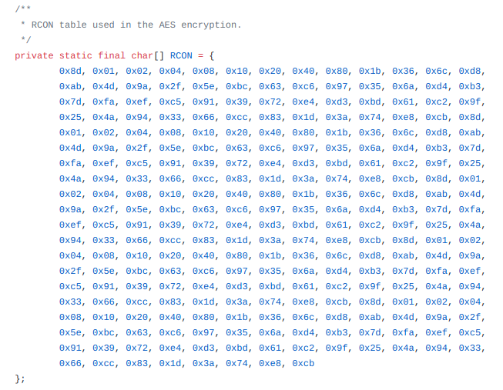
MOTIVES
Why encoding over encryption ?
AES
RC4
RSA

Slide 7

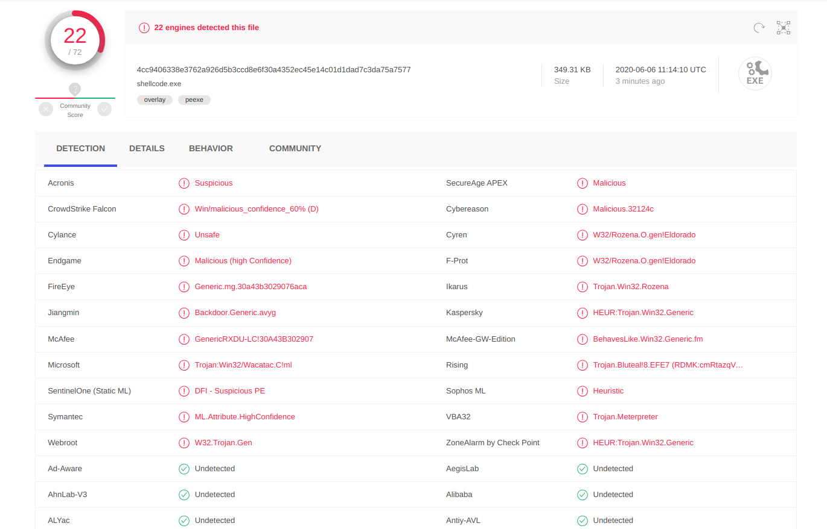
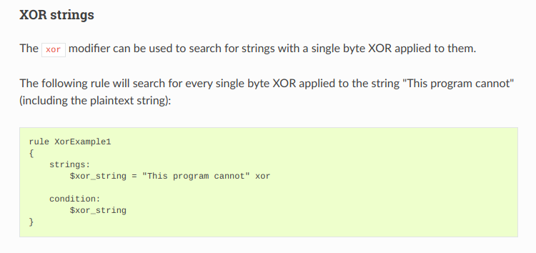
High Detection Rate
Most of the encoders are very old
Insufficient cipher algorithms (Basic XOR,Single Key...)
All can be detected by rule based static detection

Slide 8
02
GENERIC ENCODERS

Slide 9
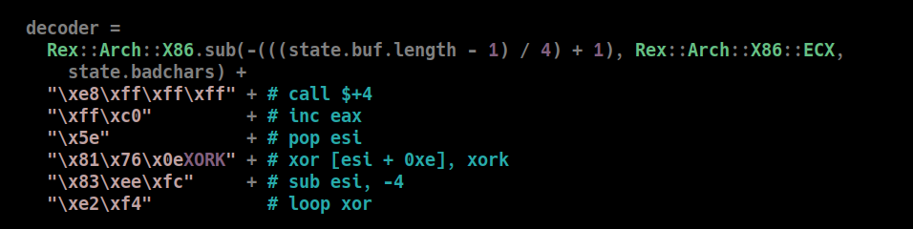
Generic Encoder
DECODER
ENCODED SHELLCODE

Slide 10
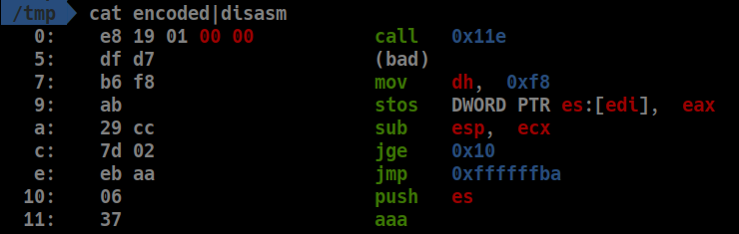
Generic Encoder
CALL
ENCODED SHELLCODE
DECODER

Slide 11
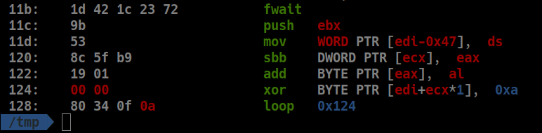
Generic Encoder
CALL
ENCODED SHELLCODE
DECODER

Slide 12
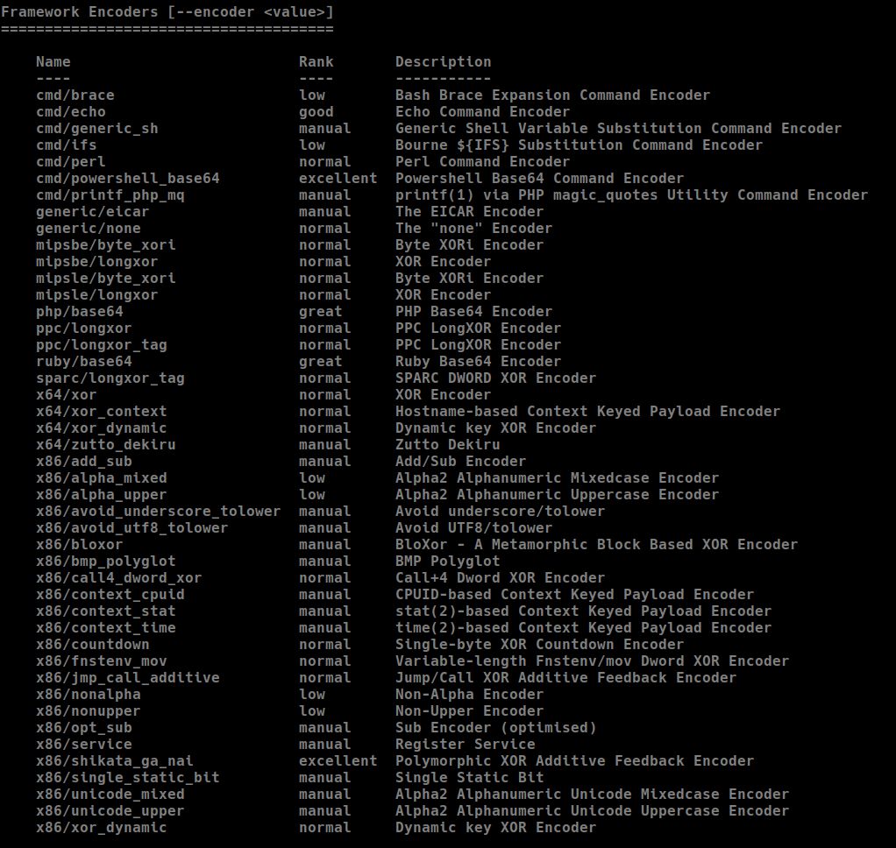

Slide 13
WHAT IS COMMON?

Slide 14
03
AV DETECTION VECTORS

Slide 15
LOOP CONDITIONS IN ASSEMBLY
LOOP
LOAD STRING
LOOP CONDITION
CONDITIONAL JUMPS
REP

Slide 16
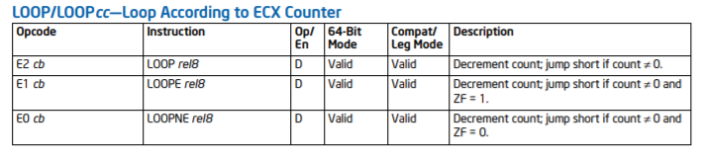
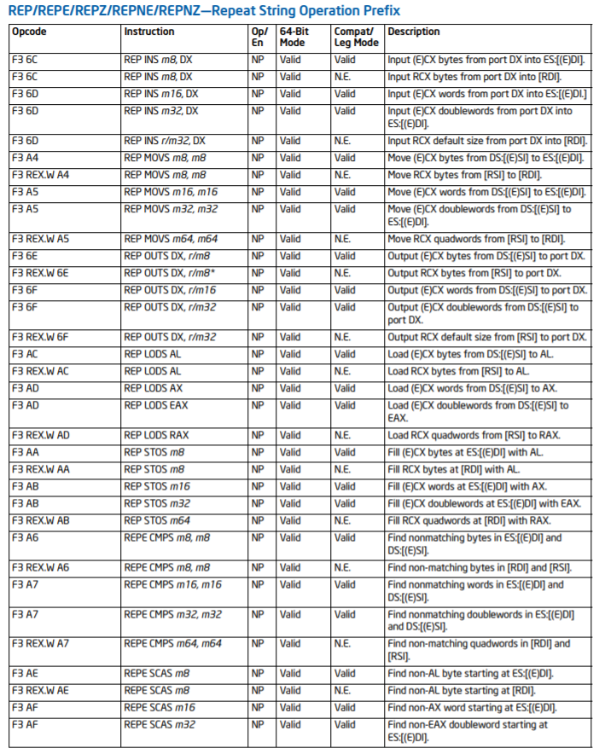
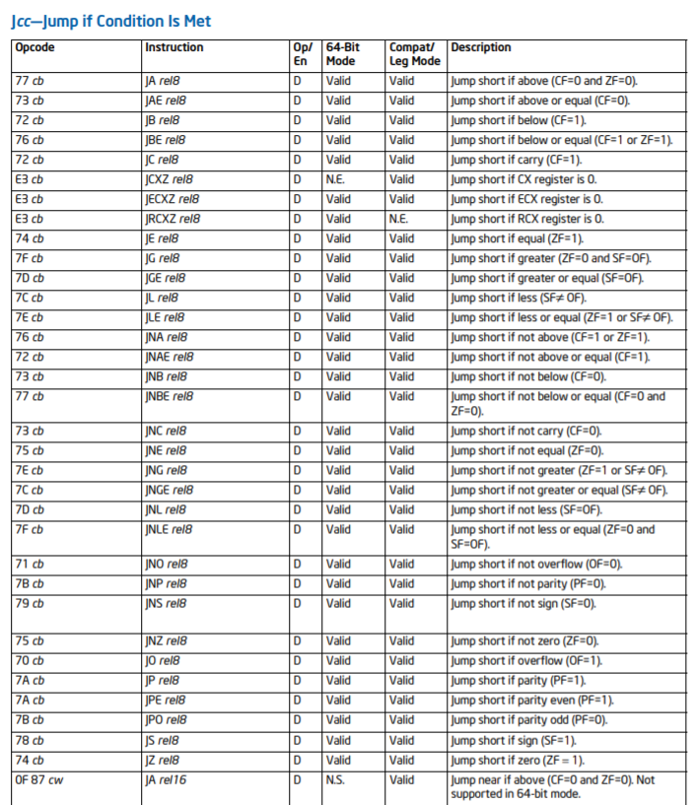
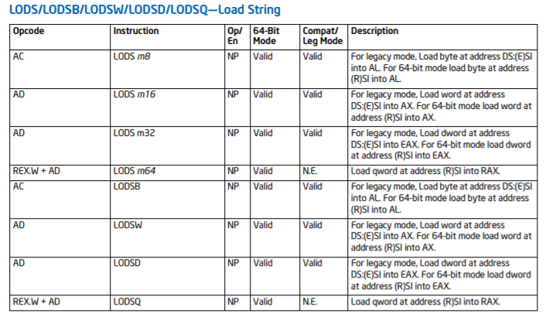
IN DEPTH

Slide 17
Weak Cipher Methods

Slide 18
Weak Cipher Methods
The known-plaintext attack (KPA) is an attack model for cryptanalysis where the attacker has access to both the plaintext (called a crib), and its encrypted version (ciphertext).

Slide 19
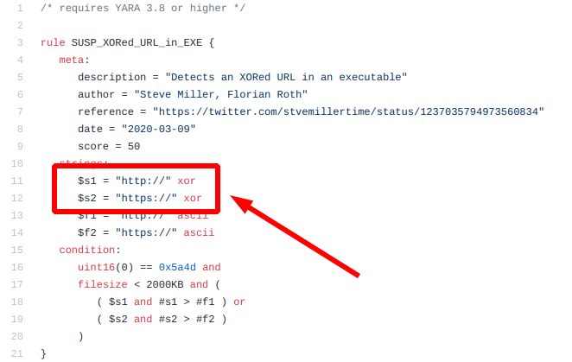
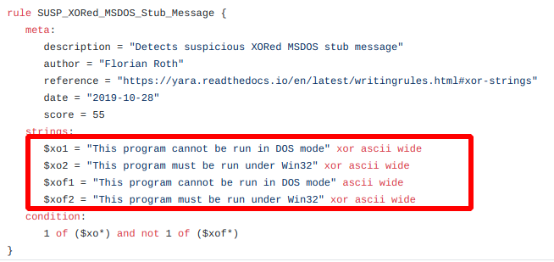
Weak Cipher Methods

Slide 20
Weak Cipher Methods

Slide 21
04
PRIOR WORK

Slide 22
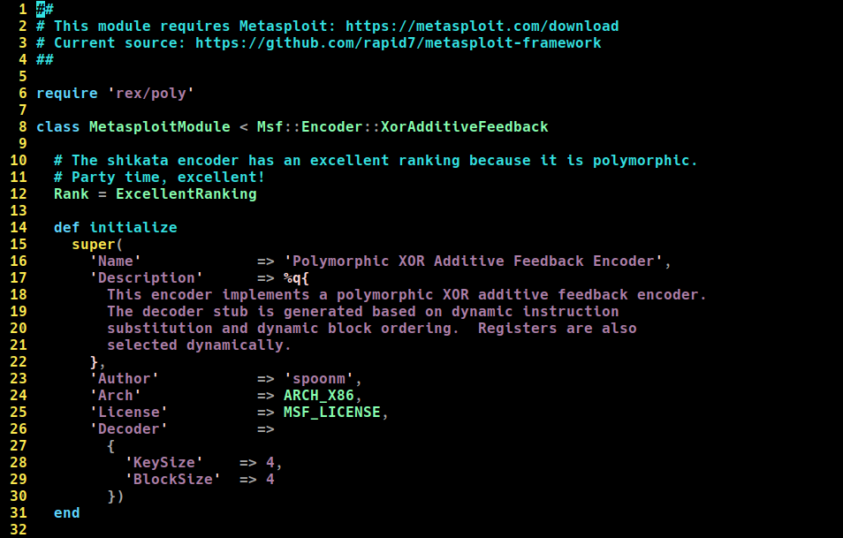

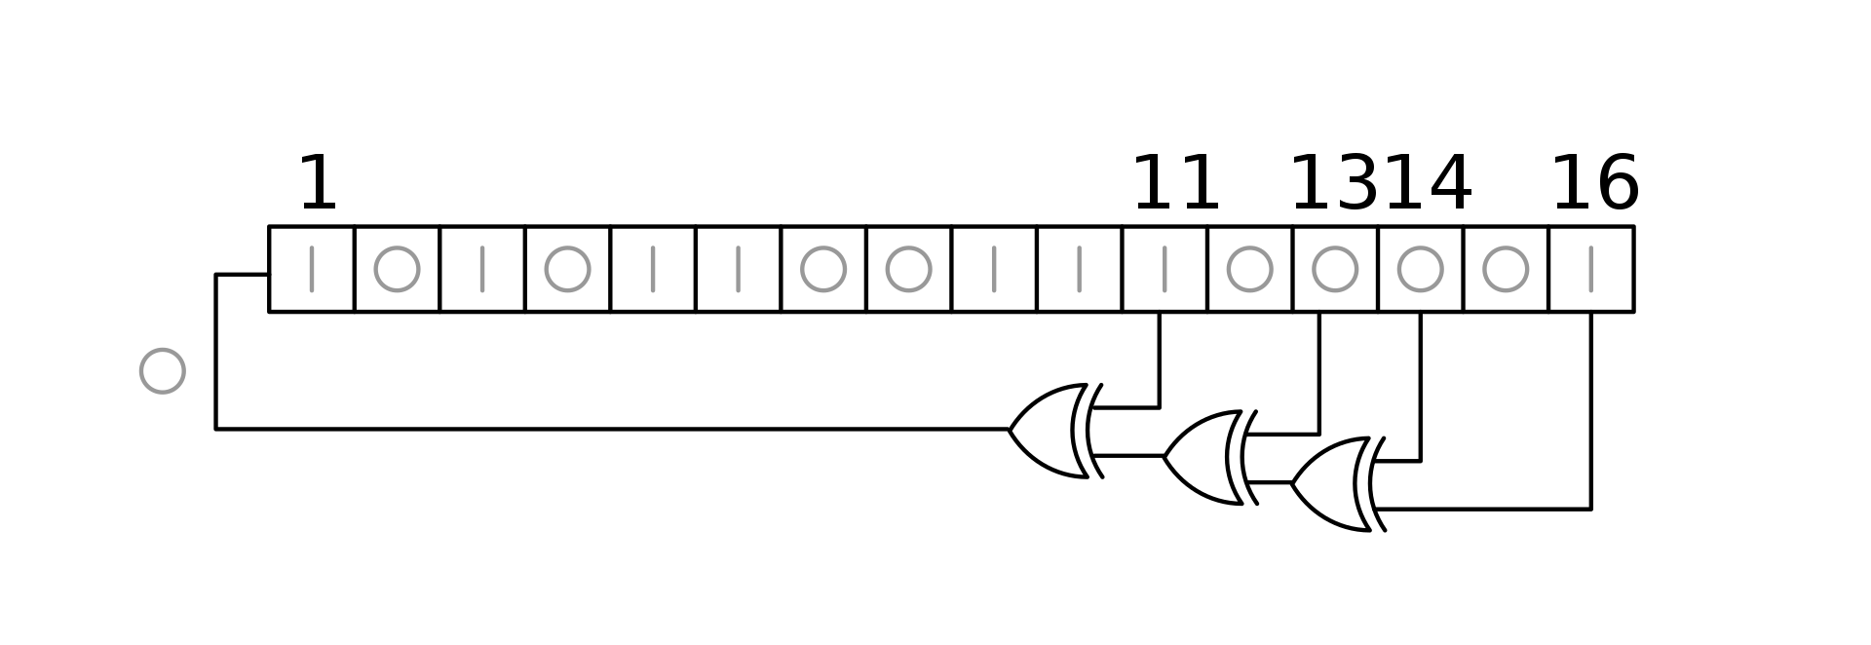
Introducing Shikata Ga Nai

Slide 23
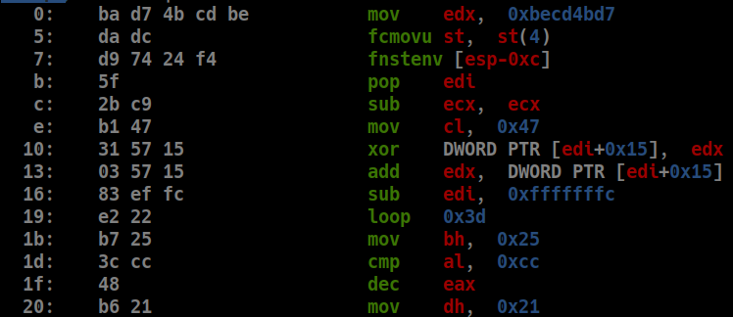
Shikata Ga Nai ADFL
GET IP
SET SHELLCODE SIZE
LOOP

Slide 24
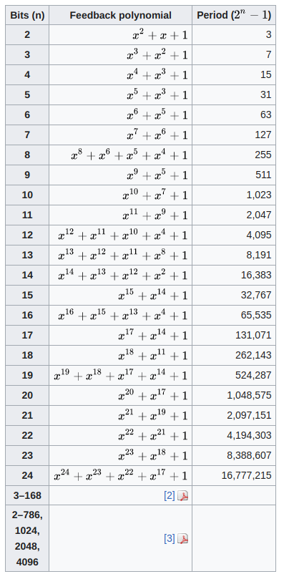
Shikata Ga Nai ADFL

Slide 25
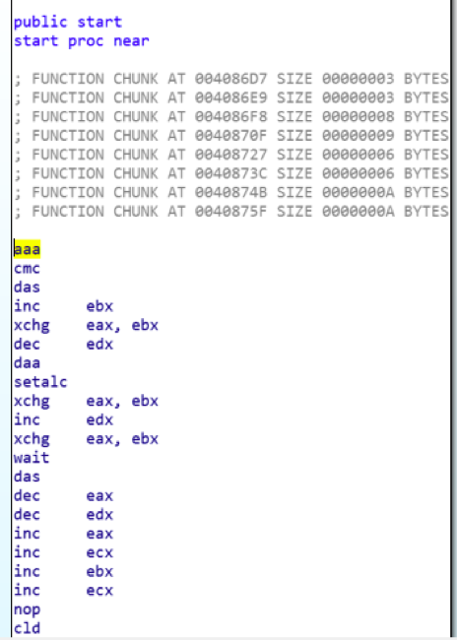

SGN Junk Instructions
Add junk instructions for better polymorphism

Slide 26
Pros & Cons
Pros:
Good cipher method
Better polymorphism with junk instructions
Cons:
Decoder loop still visible
Shady IP retrieval
No x64 support

Slide 27
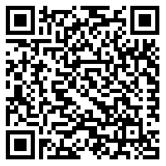
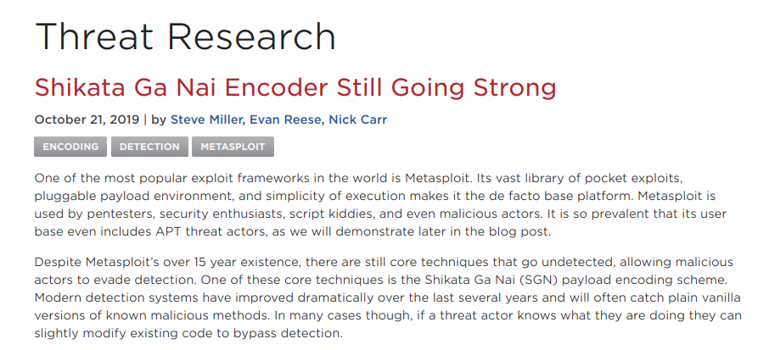
Pros & Cons
Pros:
Good cipher method
Better polymorphism with junk instructions
Cons:
Decoder loop still visible
Shady IP retrieval
No x64 support
https://www.fireeye.com/blog/threat-research/2019/10/shikata-ga-nai-encoder-still-going-strong.html

Slide 28
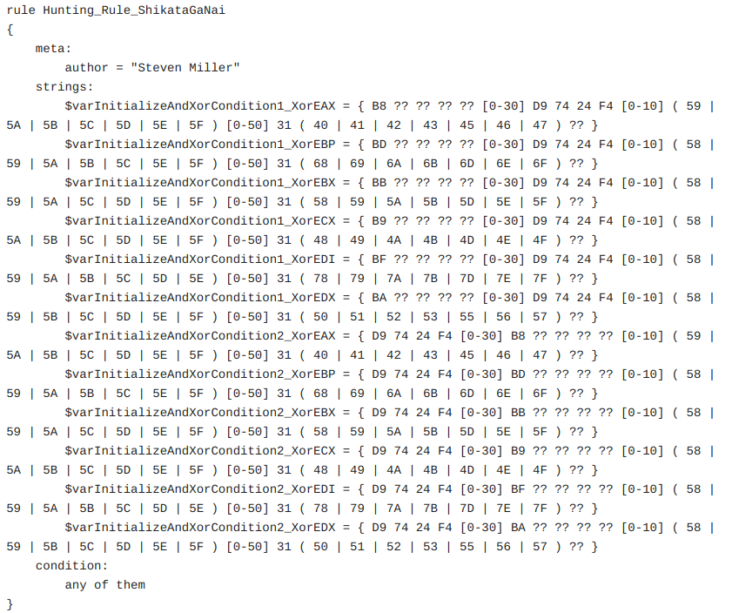
Pros & Cons
Pros:
Good cipher method
Better polymorphism with junk instructions
Cons:
Decoder loop still visible
Shady IP retrieval
No x64 support
https://www.fireeye.com/blog/threat-research/2019/10/shikata-ga-nai-encoder-still-going-strong.html

Slide 29
LETS TEST IT

Slide 30
05
REIMPLEMENTATION

Slide 31
NEW GENERATION POLYMORPHIC ENCODER RECIPE
NO LOOP CONDITION
MORE JUNK INSTRUCTIONS
SMALLEST ADFL DECODER

Slide 32
Encode Decoder Stub !
CALL
DECODER
ENCODED DECODER
ENCODED DECODER
ENCODED SHELLCODE
ENCODED SHELLCODE
ENCODED SHELLCODE
Encoder decoder with random schema
Add decode instructions
DECODE INSTRUCTIONS
Decode instructions are sequential logical operations for decoder address (has no loop condition).

Slide 33
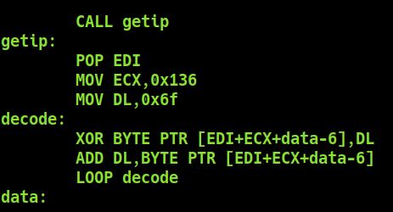
NEW DECODER
New ADFL Decoder.
1 byte XOR seed
Random register selection
Total Decoder Size: 29 byte

Slide 34
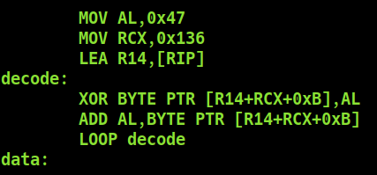
NEW DECODER
New x64 ADFL Decoder.
1 byte XOR seed
Random register selection
Took advantage of x64 relative addressing for retrieving IP
Total Decoder Size: 28 byte

Slide 35
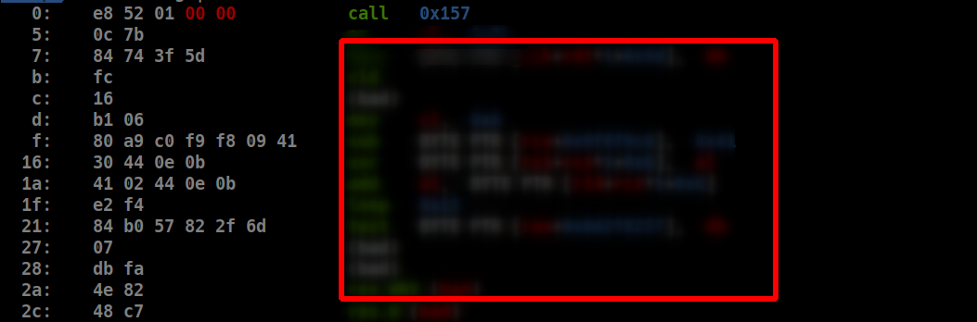
Encode Decoder Stub
CIPHERED
PAYLOAD
Jump over the ciphered payload

Slide 36
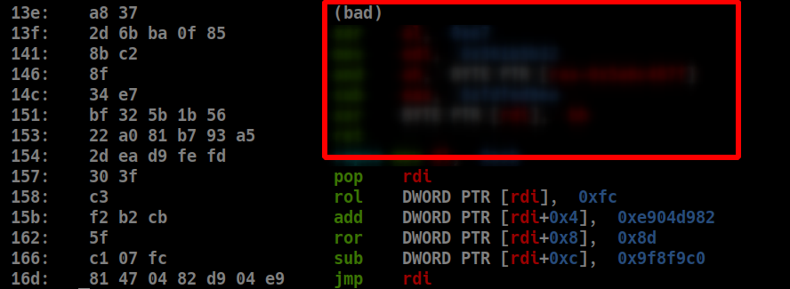
Encode Decoder Stub
CIPHERED
PAYLOAD
Jump over the ciphered payload
Get decoder stub address (POP RDI)
Decode the decoder stub 4 byte at a time with a random schema

Slide 37
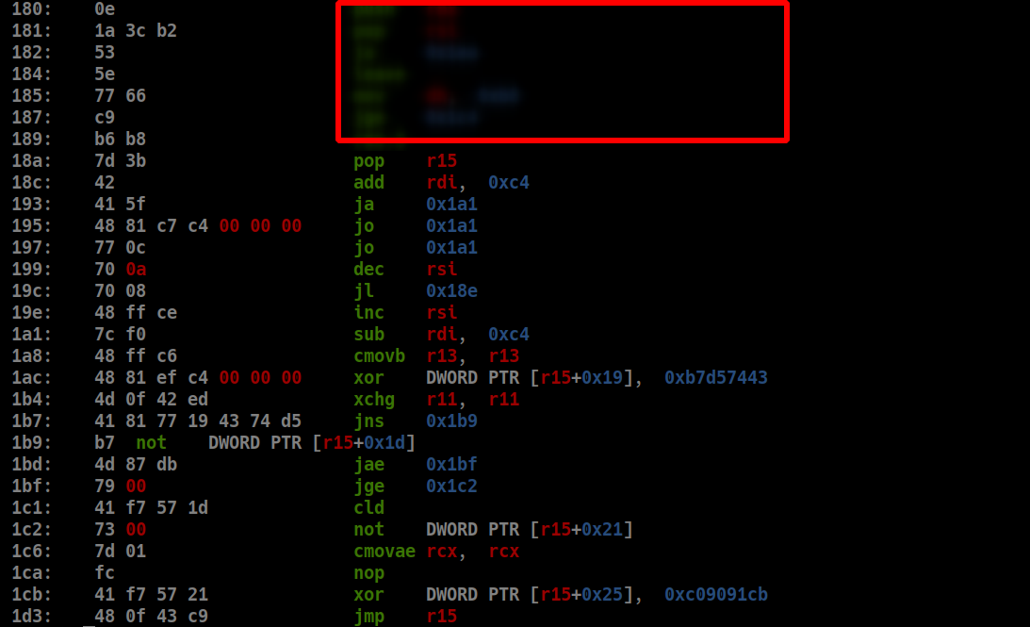
Obfuscate Decoder Decoder Stub :)
CIPHERED
PAYLOAD

Slide 38
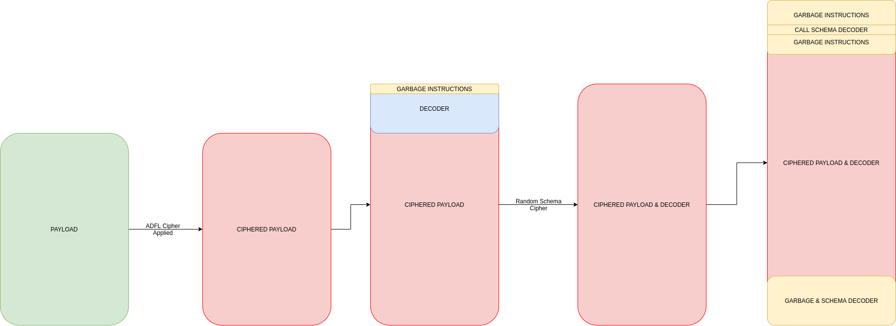
FINAL ENCODER FLOW

Slide 39
06
FINAL PRODUCT

Slide 40
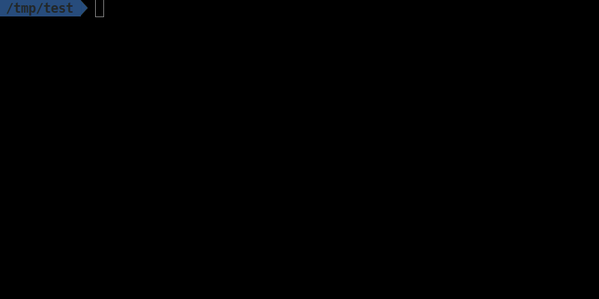
github.com/egebalci/sgn

Slide 41
LETS TEST IT !

Slide 42
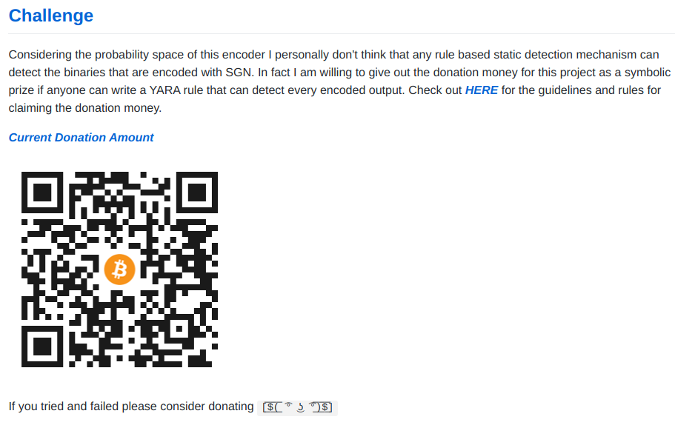
github.com/egebalci/sgn/wiki/Challange_Guidelines

Slide 43
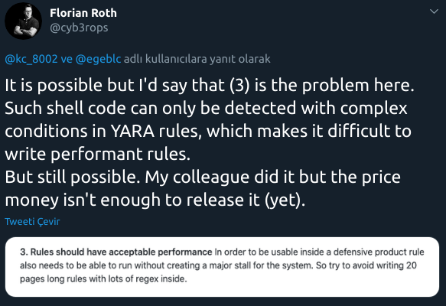
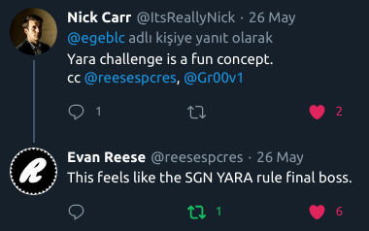
github.com/egebalci/sgn/wiki/Challange_Guidelines

Slide 44
THANKS
Does anyone have any questions?
ege.balci@invictuseurope.com
Blog: Pentest.blog
Github: @egebalci
Twitter: @egeblc

